Slide 1
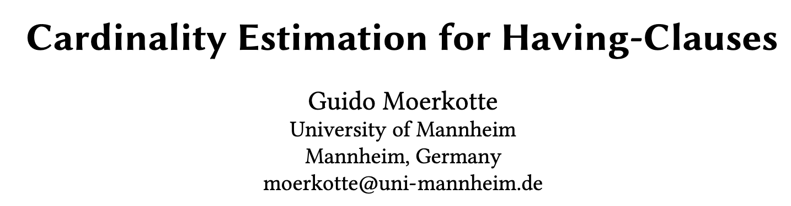

Slide 2

Background
Group-By-Having
The relevance of considering cardinality estimation for GBH-queries becomes clear if we consider them occurring nested in some larger query.
Examples are TPC-H Q18 and TPC-DS Q8, Q14, Q23, Q44, and Q64. In these cases, the optimal join order and the choice of the optimal join implementation highly depends on the cardinality of the GBH-queries.

Slide 3
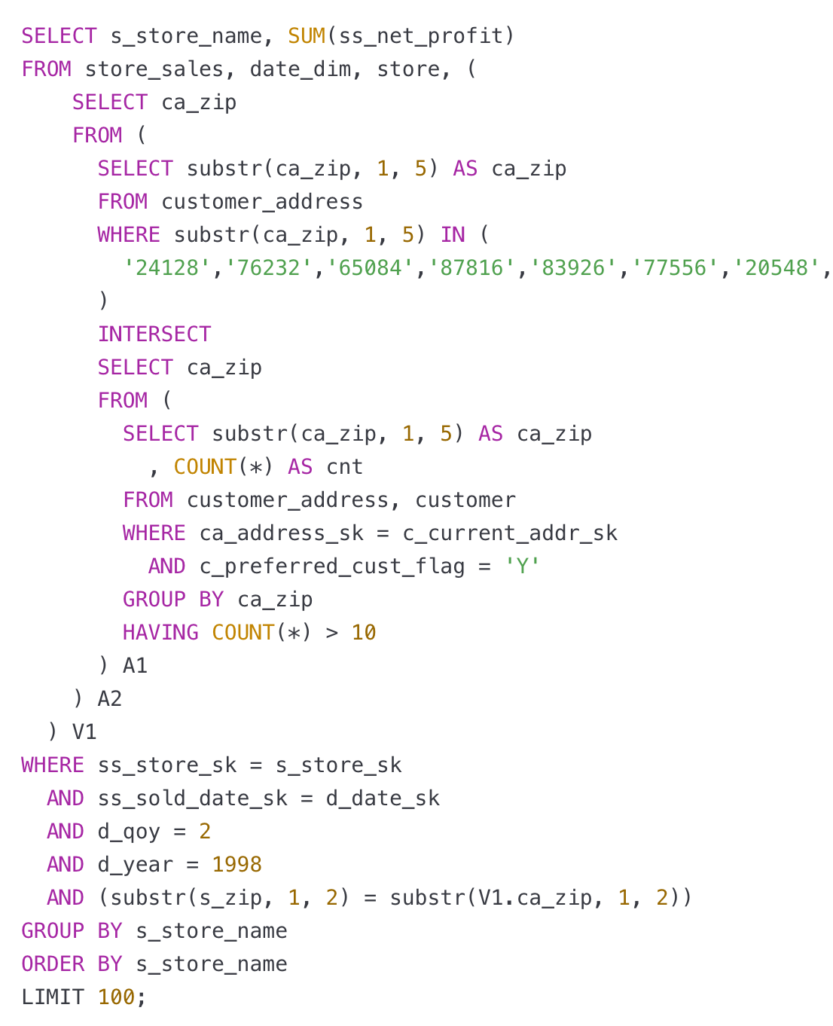
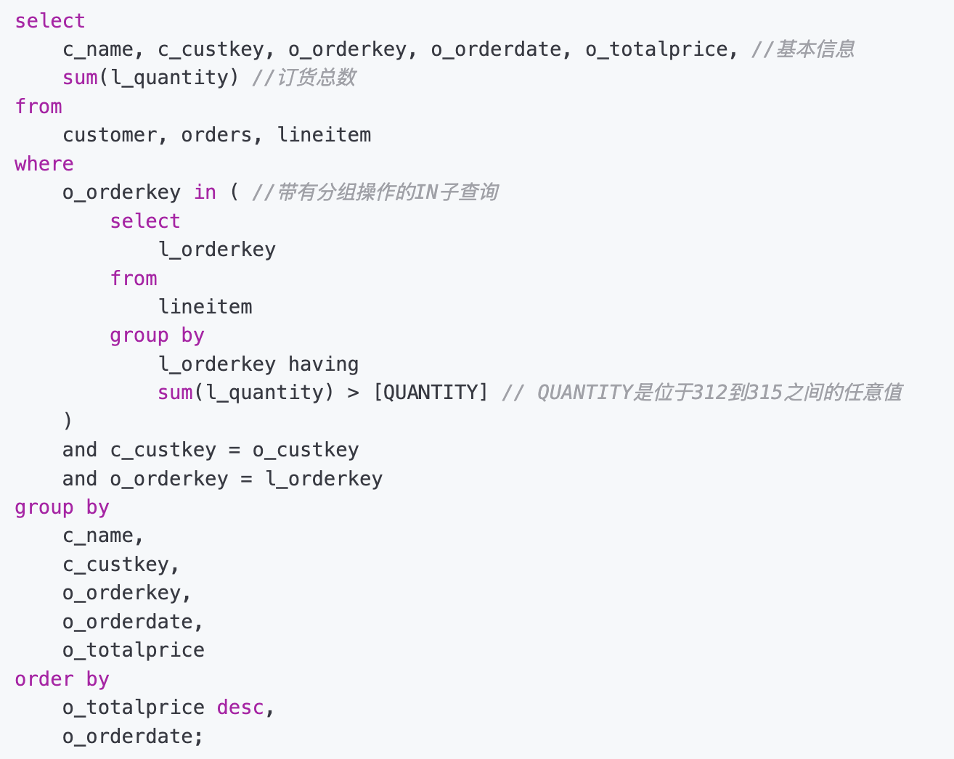
Background
TPC-H Q18:
TPC-DS Q8:

Slide 4
Oracle
当 HAVING 中包含聚合函数（如 HAVING MAX(...) >= x AND MIN(...) <= y），Oracle 将其视为“未知表达式”。
优化器会使用内置默认选择率来估计结果行数，比如：
每个未知范围谓词默认选择率为 5%
多个谓词时取乘积：例如两个谓词为 0.05 * 0.05 = 0.0025（即 0.25%）
这常常 严重偏离真实结果，即使实际的 HAVING 条件并没有真正过滤任何数据。

Slide 5
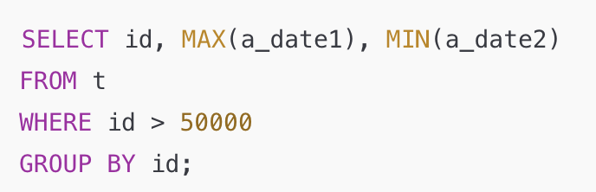
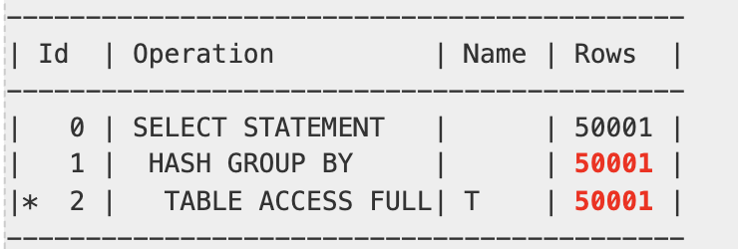
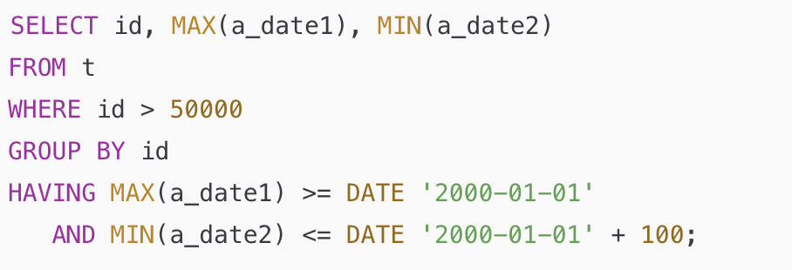
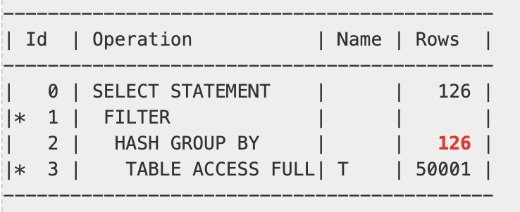
Oracle
t 表有10万行，优化器正确估计为 50001 行（id 是唯一的）
实际上这个 HAVING 并没有筛掉任何数据，但 Oracle 估计为仅 126 行，即 50001 * 0.0025

Slide 6
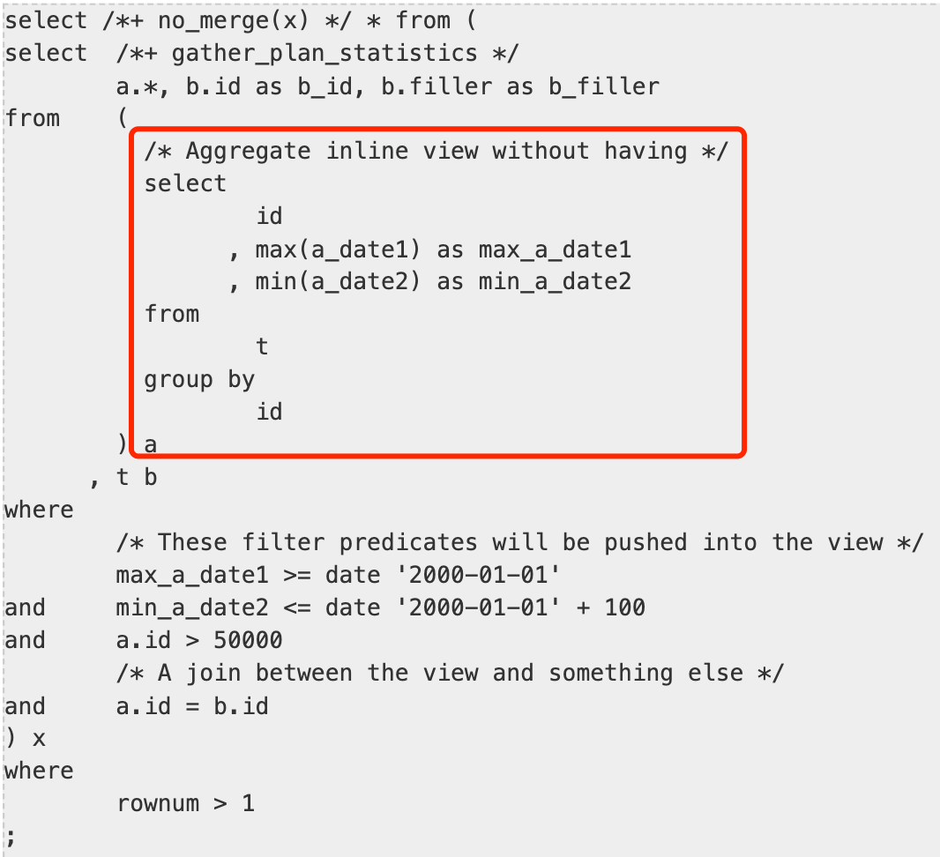
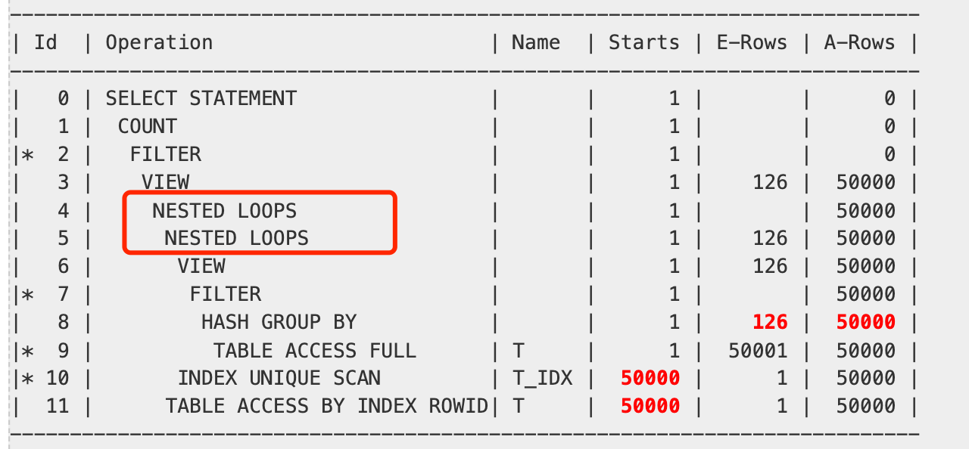
Oracle
由于基数估计不准确，导致优化器选择使用了 NESTED LOOP（嵌套循环） 作为连接操作。这在实际循环次数远高于估计值的情况下，往往是一个糟糕的选择。这种错误的基数估计可能会在整个执行计划中产生连锁反应，带来严重的性能影响。

Slide 7
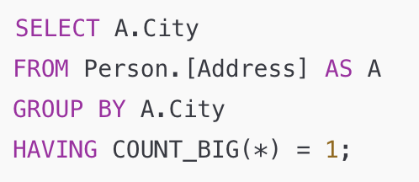
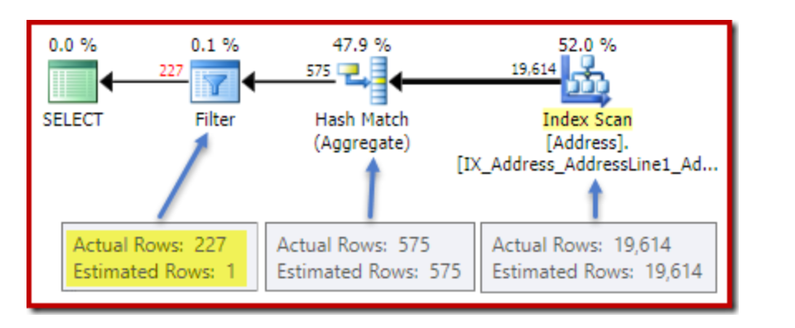
SQL Server
The post-execution (actual) plan shows a perfect estimation for the aggregate; however, the estimate for the HAVING clause filter is poor!
原因分析：聚合表达式是一个新的计算列。虽然优化器知道总共有 575 行，但它对这些行中 COUNT 值的分布一无所知。数据库没有关于这个新列的统计信息，无法准确估计其分布。在 SQL Server 的估算框架中，这种谓词基本上被视为“未知选择率”（unknown selectivity），所以采用默认的选择率。

Slide 8
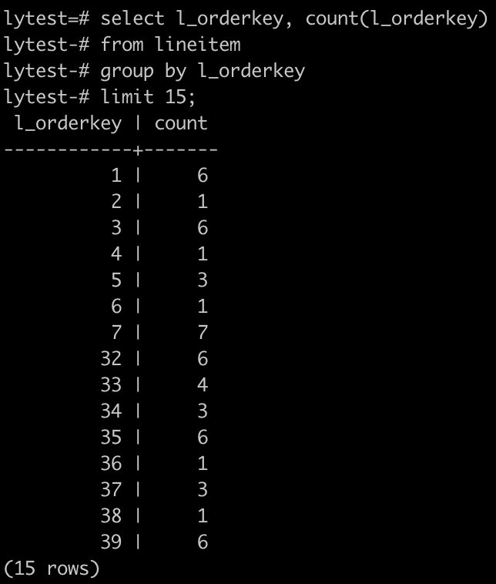
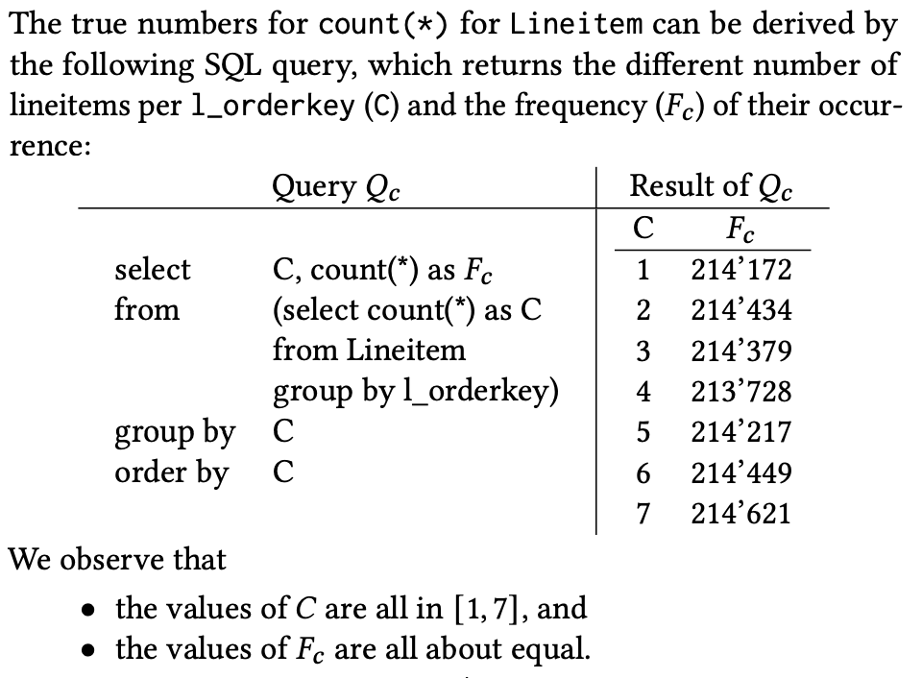
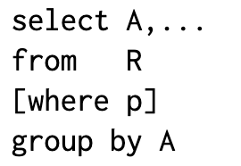
Preliminaries
l_orderkey 本身的分布
count(l_orderkey) 的分布

Slide 9
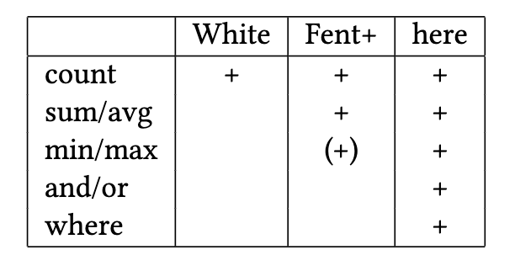
Preliminaries
Since the main focus is on uniformly distribution, we use the data from the TPC-H benchmark (with scale factor SF=1) and modifications of Query 18 to illustrate the different approaches.

Slide 10
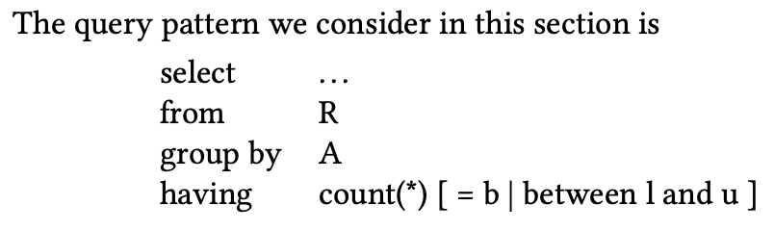
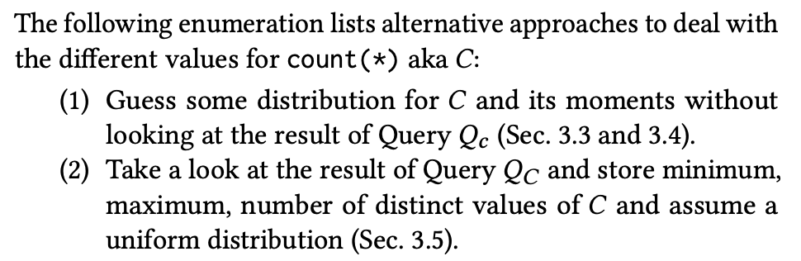
Count(*)

Slide 11

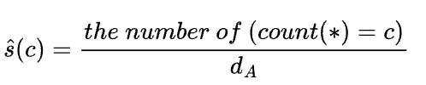
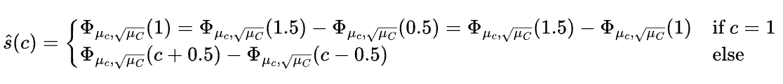
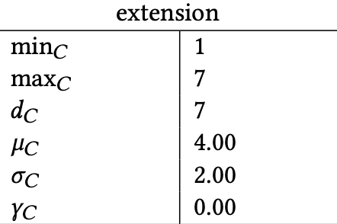
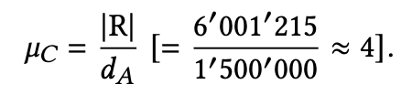

Normal Distribution (White, SQL Server)
对于 count(*)(也就是C) = b的数量，只需要计算 count(*) = b 的概率，然后乘以分组总数 d_{A} (不同值的数量)，就可以得到估计的分组个数
如果s(c)完全准确，
概率
分组总数
In short, a normal distribution for the values of count(*) is assumed.
核心思想：使用正态分布的累积分布函数CDF做概率计算
The estimated selectivity of count(*)=c is

Slide 12
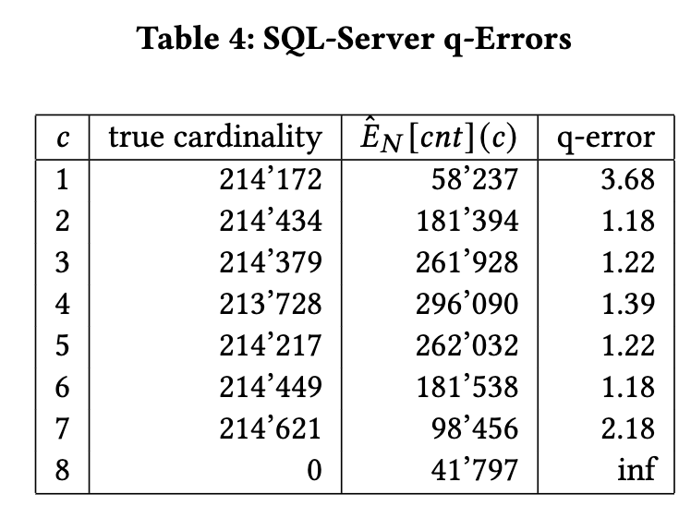
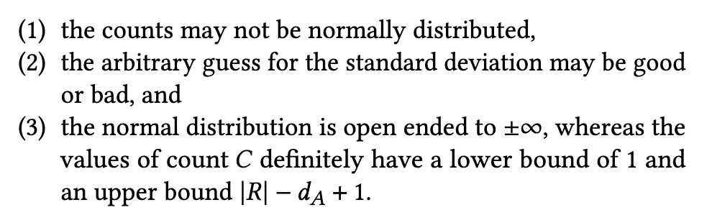
Evaluation
Using the SQL Server method to estimate the cardinality for having count(*) = c, we get for different 𝑐 in Table 4.
There comes a couple of obvious deficiencies with
this approach:

Slide 13

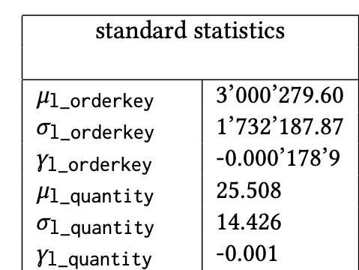
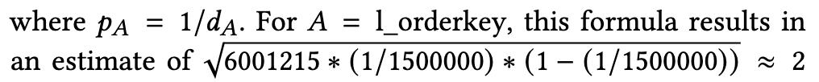
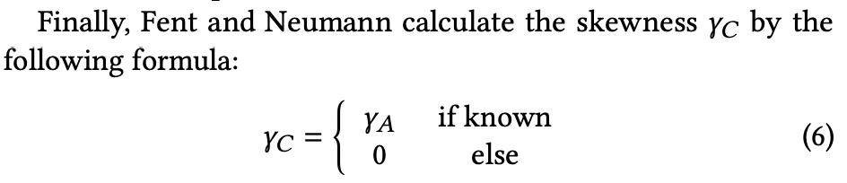
Skew-Normal Distribution (Fent, Umbra)
In the approach of Fent and Neumann, the mean 𝜇_{𝐶} is calculated the same way as in the SQL-Server approach. The standard deviation is assumed to be
With these three parameters, a skew-normal distribution SN(𝜇_{𝐶} , 𝜎_{𝐶} , 𝛾_{𝐶} ) is used to produce the estimates, which we also call SN_{𝐶} (𝜇_{𝐶} , 𝜎_{𝐶} , 𝛾_{𝐶} ) for further reference.

Slide 14
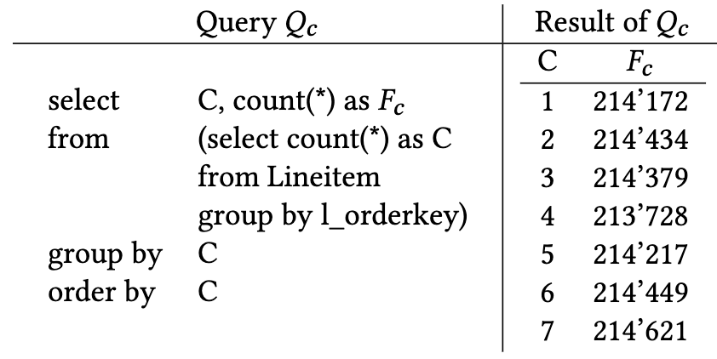
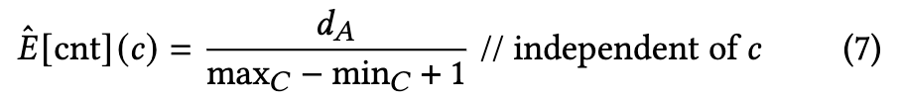
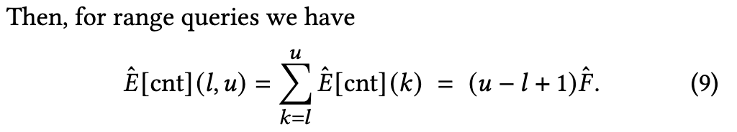
extended simple profile, eSP
We now extend the simple profile by three numbers: 𝑑_{𝐶} , min_{𝐶} , and max_{𝐶} .
Since the counts are always integers, the simple profile applies the discrete uniform distribution.
d_{A} / 7
如果count值不是稠密的，需要用d_{C}替代分母

Slide 15
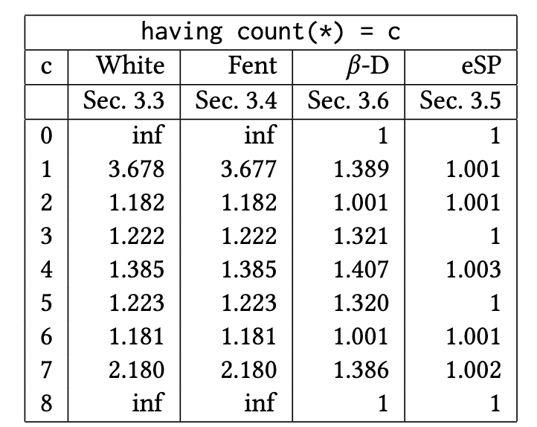
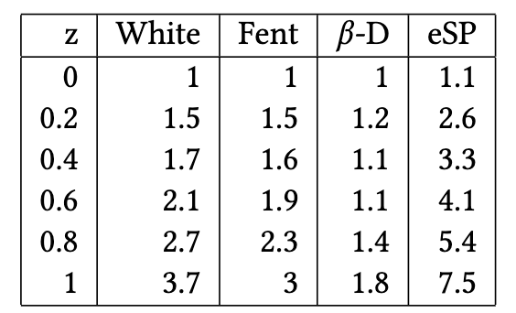
Evaluation
We observe that there is virtually no difference between the estimation method of SQL-Server as described by White and the one proposed by Fent and Neumann.
𝐴 are Zipf distributed in [1, 1000]
having predicate: count(*) > 1000

Slide 16
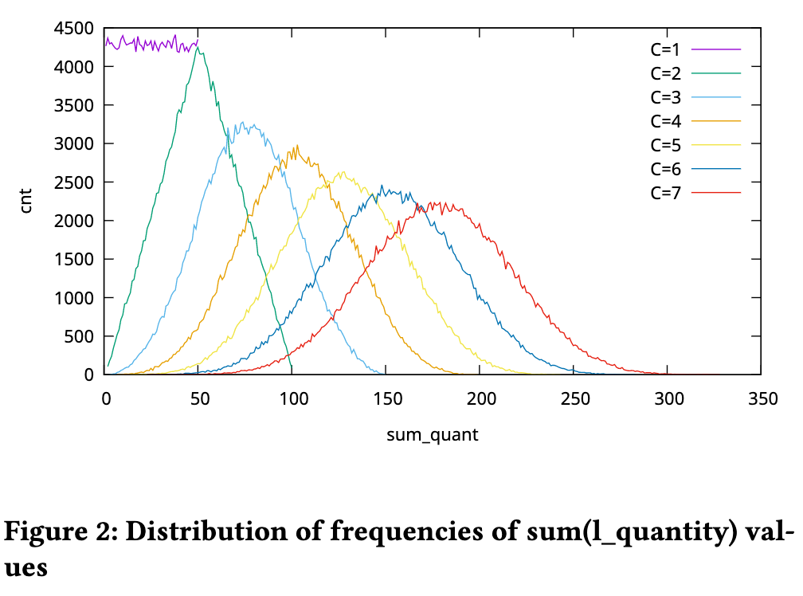
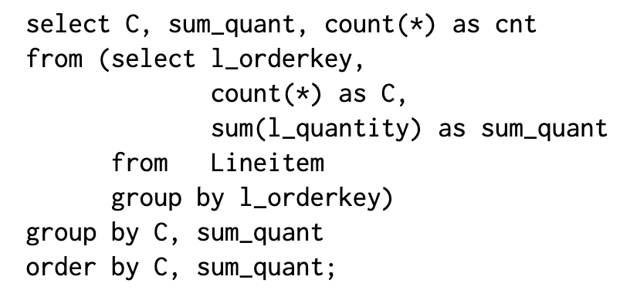
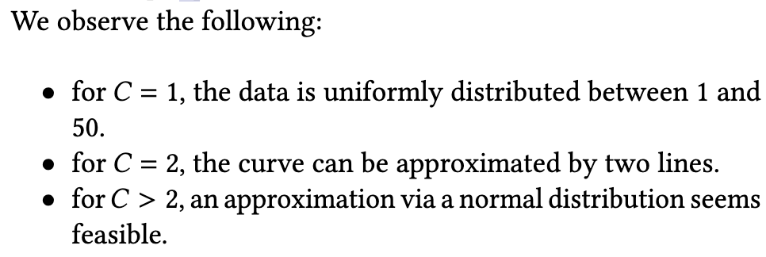
SUM(B)
This distribution can be calculated via Query 𝑄_{𝑑} :

Slide 17
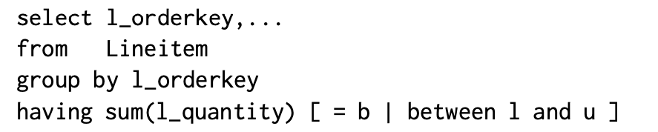
Skew-Normal Distribution (Fent, Umbra)
minimal theoretically possible value of sum(B)
min𝐶 ∗ min𝐵
3 | 2
4 | 2
5 | 2
7 | 3
8 | 3
9 | 3
maximal theoretically possible value of sum(B)
max𝐶 ∗ max𝐵
3 3 4 4 5 5
2 | 3
3 | 3
min𝐶 ∗ min𝐵 = 2 * 3 = 6
7 7 7 8 8 8 9 9 9
max𝐶 ∗ max𝐵 = 3 * 9 = 27
a skew-normal distribution SN_{𝐵} = SN(𝜇_{𝐵}, 𝜎_{𝐵}, 𝛾_{𝐵} )
SN_{𝐶} (𝜇_{𝐶} , 𝜎_{𝐶} , 𝛾_{𝐶} )
SN_{sum} = SN(𝜇_{𝑠} , 𝜎_{𝑠} , 𝛾_{𝑠} ) = SN_{𝐶} ∗ SN_{𝐵}

Slide 18
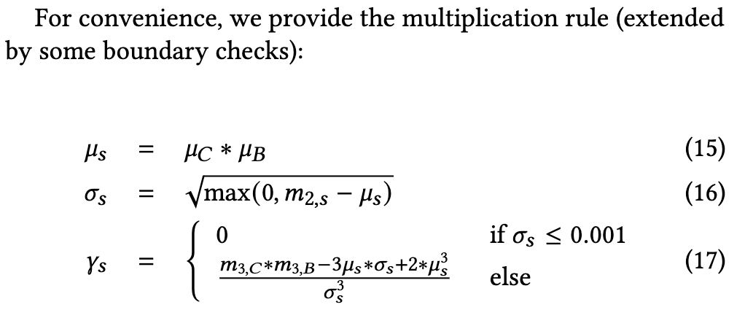
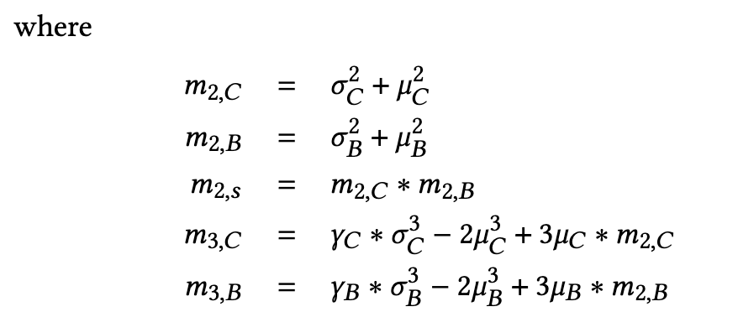
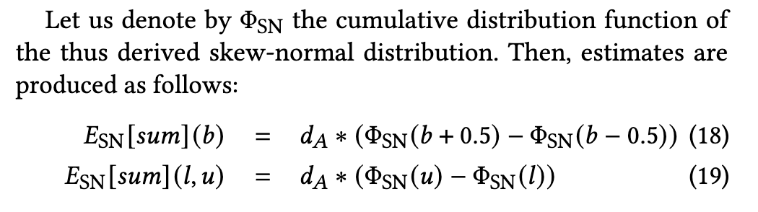
Skew-Normal Distribution (Fent, Umbra)

Slide 19
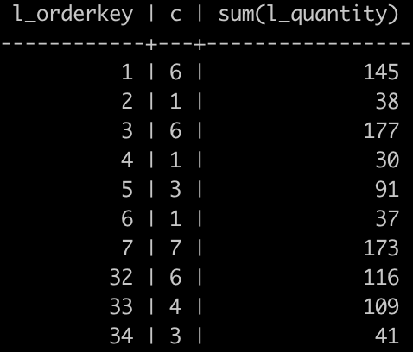


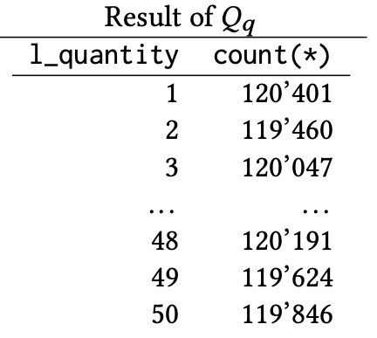
Integer B: Counting Integer Compositions(IC)
对于不同的COUNT值，sum(B) 的分布也会变化。
We start with the case 𝐶 = 1.
Thus, we can conclude that for any 𝑏 the estimate is
or in general
under the uniform distribution assumption for 𝐵.

Slide 20
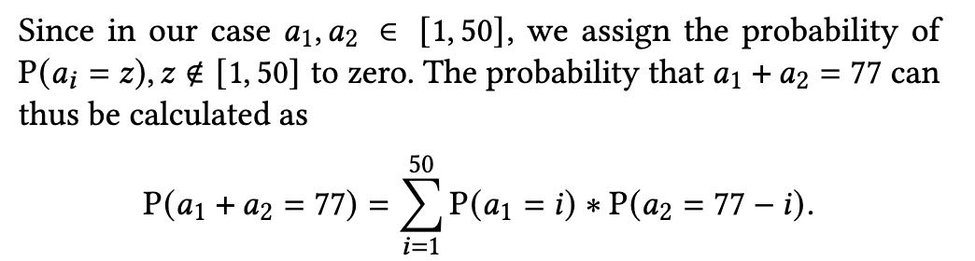
Integer B: Counting Integer Compositions(IC)
Next is the case 𝐶 = 2.
Example: sum(l_quantity) =77
Thus, we have the following possibilities for 𝑎1 and 𝑎2 both ≥ 1:
We must have two quantities 𝑎1 and 𝑎2 which sum up to 77

Slide 21
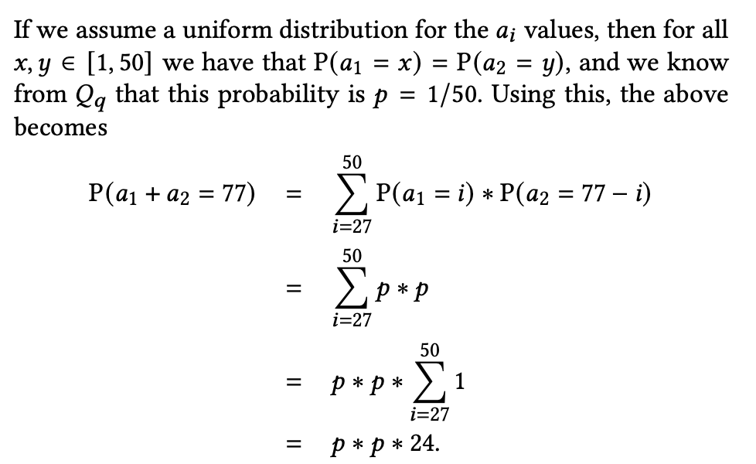
Integer B: Counting Integer Compositions(IC)
The estimate is then (1/50) ∗ (1/50) ∗ 24 ∗ 𝐹2 = (1/50) ∗ (1/50) ∗ 24 ∗ 214434 = 2058. The true value is 1979.
概率
元组总数

Slide 22
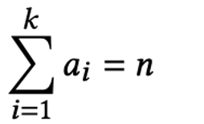
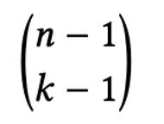
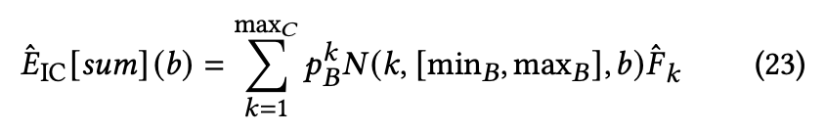
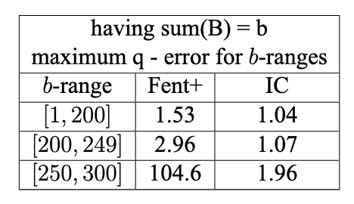
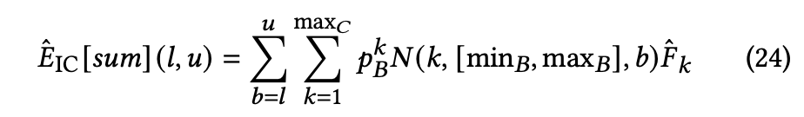
Integer B: Counting Integer Compositions(IC)
For a positive integer n > 0, a tuple (a₁,…,a_{k}) of positive integers a_{i} > 0 with
is called a k-composition of n. The number of k-compositions is
Unfortunately, this is not the case in our estimation task: the parts a_{i} must be in [1, 50].
An 𝑆-restricted 𝑘-composition requires 𝑎𝑖 ∈ 𝑆 for some set of positive integers 𝑆. Providing a closed form expression for the number of 𝑆-restricted 𝑘-compositions is not possible.

Slide 23
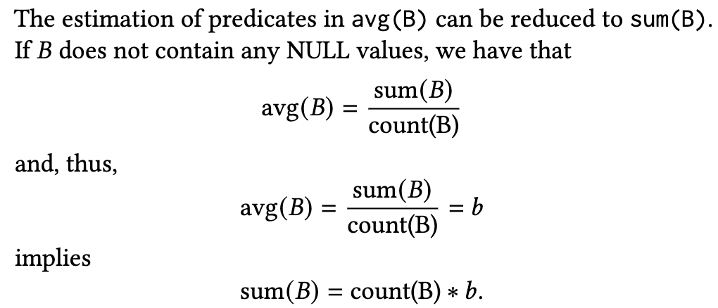
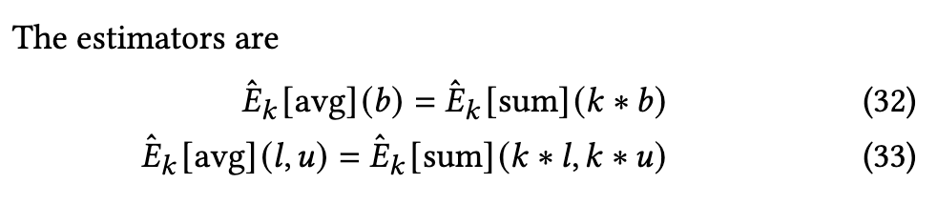
AVG(B)

Slide 24
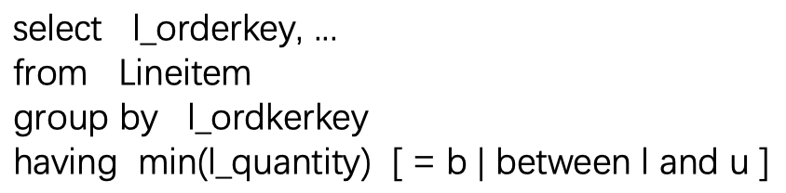





MIN(B)
p: selectivity of 𝐵 = 𝑏 q: selectivity of 𝐵 ≥ 𝑏
under the uniform distribution assumption, we can use
𝑝 = 𝑝_{𝐵} = 1/𝑑_{𝐵} and
二项分布概率

Slide 25


MIN(B)
p: selectivity of B between l and u q: selectivity of B between min_{𝐵} and l

Slide 26

Conjunctions(AND)
Applying the independence assumption is bound to fail.

Slide 27


Conjunctions(AND)
Define 𝐾 = [𝑐, 𝑑] ∩ [min𝐶, max𝐶]. then, we have

Slide 28


Disjunctions(OR)

Slide 29





WHERE-CLAUSE
对于原本有k条记录的分组，经过p过滤后剩下c条记录的概率（二项分布）
Notes:
41公式表示的含义是，count值为c的这些分组中，有多少组是经过p过滤后恰好剩c个元组得到的

